Slide 1
Semester ONE - Week 5 – TOPIC 5
The concept of the Golden Thread in your study

Slide 2
The concept of the Golden Thread in your study
• Explain the Golden Thread as a coherence and alignment principle in research writing.
• Identify where the Golden Thread commonly breaks (misaligned language, design, and questions).
• Apply a practical checklist to test alignment between title, problem, questions, objectives, methods, analysis, and conclusions.
• Use strategies to maintain and repair coherence while a study evolves over time.

Slide 3
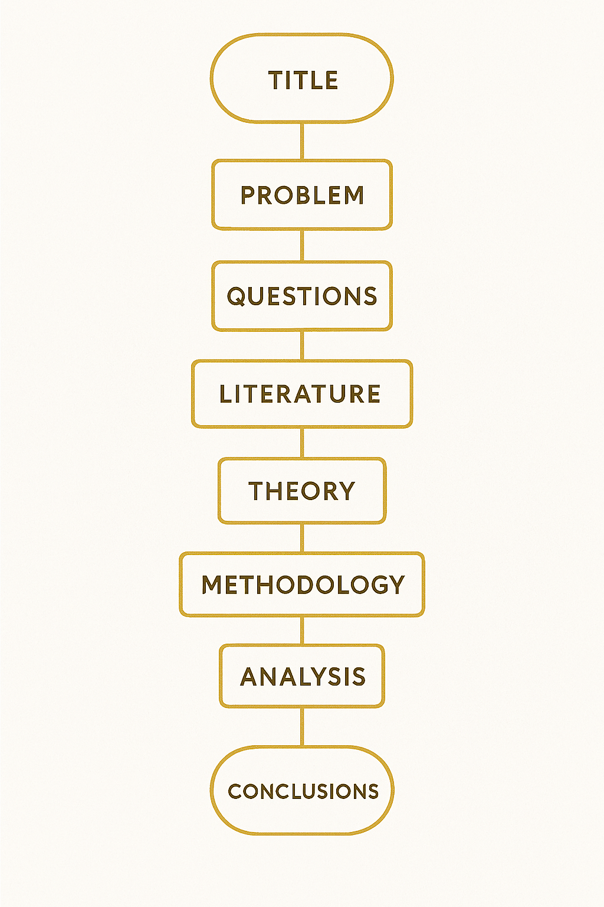
The concept of the Golden Thread in your study
The Golden Thread is the line of logical coherence that connects every part of a research project, from the title and problem, through questions, objectives, literature, theory, methodology, analysis, and conclusions. (Francke, 2024; Clarence, 2015; Spooner & Barnard, 2024)

Slide 4
A. Why is the Golden Thread important in research?
It prevents the study from becoming a collection of disconnected parts.
It helps the reader see clearly what question you asked, why it matters, and how you answered it.
It supports validity and reliability by ensuring that each step is logically justified and linked to the overall aim. (Francke, 2024)
This is the central argument that pulls through the whole study, creating coherence across chapters. (Clarence, 2015)

Slide 5
B. The essence of the Golden Thread Think of the Golden Thread as a guiding line running through your entire project:
Research title
(the central focus in a few words).
2. Research problem
(the issue or gap that makes the study necessary)
3. Research questions
(what you need to answer to address the problem)
4. Objectives
(what you will do to answer the questions)
5. Literature and theory
(the concepts and scholarly conversation that frame your argument)
6. Methodology
(how you will produce evidence that answers the questions)
7. Data analysis and findings
(how evidence is interpreted in relation to the questions)
8. Conclusions and implications
(how the study resolves the problem and explains significance)

Slide 6
C. Importance of consistency across the research components
Title to problem
The problem statement must directly relate to the topic signaled by the title
Problem to questions
Research questions are derived from the problem and specify what must be investigated.
Questions to objectives
Objectives translate questions into achievable steps. If an objective is not linked to a question, it will not be investigated.
Literature and theory to questions
Literature and theory should be selected because they help answer the research question and justify the study.

Slide 7
D. Alignment in methodology
1
Data collection choices must be driven by the research questions and objectives, not by convenience or habit.
2
Analysis techniques must be appropriate for the type of data and must directly answer the research questions.
3
A Golden Thread breaks when the research design does not match the promised approach, for example, exploratory qualitative framing paired with hypotheses and variables, or explanatory quantitative designs paired with open-ended why and how questions.

Slide 8
E. Drawing conclusions that tie back
1
Conclusions must answer the research questions and meet the objectives.
2
Implications must follow logically from the findings, not from personal preference.
3
Readers should not finish your work asking: “So what? Why did I read this?” The Golden Thread is the answer to that question.

Slide 9
F. Transparency and clarity
1
Your reader should be able to trace how each part of the study leads to the next with no gaps or contradictions.
2
Write as scientific communication: communicate the research contribution itself, not the full intellectual history of every false start.
3
Use practical reminders to stay on track, for example, keeping the main research question visible while writing so you do not drift into interesting but irrelevant detail.

Slide 10
G. Analogy: a lawyer in court The Golden Thread is like a well-constructed legal argument:
1
Clear evidence supports claims (data support research questions).
2
Logical reasoning connects evidence to claims (analysis links data to questions).
3
A verdict follows logically from evidence and reasoning (conclusions follow from findings).

Slide 11
H. Practical Golden Thread checklist
Does the title match the problem statement in focus and scope?
Does the problem clearly state the gap, broken practice, or missing knowledge?
Do research questions flow from the problem and stay within the same approach (qualitative or quantitative)?
Does each objective map to a research question (one-to-one where possible)?
Is the literature review organised around concepts that help answer the question?
Does the methodology produce evidence that can answer each question?
Does the analysis explicitly return to the research questions and objectives?
Do conclusions and recommendations follow from findings and address the original problem?

Slide 12
J. Examples of a Good Golden Thread and a Bad Golden Thread
Example 1: Good Golden Thread (Aligned)
I. Title → Problem (Aligned)
Title: Cybersecurity Awareness Training and Phishing Risk Among University Students
Problem: Universities experience phishing incidents affecting student accounts. Although training is provided, it is unclear whether current awareness training reduces students' susceptibility to phishing.

Slide 13
J. Examples of a Good Golden Thread and a Bad Golden Thread
Example 1: Good Golden Thread (Aligned)
II. Problem → Questions (Aligned)
Main Research Question: How does cybersecurity awareness training influence phishing susceptibility among university students?
Sub-questions:
What training components are most associated with improved phishing recognition?
What outcomes are used to measure susceptibility?

Slide 14
J. Examples of a Good Golden Thread and a Bad Golden Thread
Example 1: Good Golden Thread (Aligned)
III. Questions → Objectives (Aligned)
Main Aim: To explore how cybersecurity awareness training influences phishing susceptibility among university students.
Objectives:
To identify what training components are most associated with improved phishing recognition.
To synthesise evidence on outcomes used to measure phishing susceptibility.

Slide 15
J. Examples of a Good Golden Thread and a Bad Golden Thread
Example 1: Good Golden Thread (Aligned)
IV. Literature/Theory → Questions (Aligned)
The literature focuses on phishing behaviour, the design of awareness training, user security behaviour, and evaluation measures, as these directly help answer the questions.
Why this is good: Every element uses the same focus, population, and outcome, and each part clearly supports the next.

Slide 16
J. Examples of a Good Golden Thread and a Bad Golden Thread
Example 1: Bad Golden Thread (Misaligned)
I. Title → Problem (Broken)
Title: Cybersecurity Awareness Training and Phishing Risk Among University Students Problem: The organisation lacks a firewall and needs intrusion detection to prevent malware infections.
Why it is bad: The title is about training and student phishing, but the problem is about the technical infrastructure. The study starts in one direction and then immediately shifts.

Slide 17
J. Examples of a Good Golden Thread and a Bad Golden Thread
Example 1: Bad Golden Thread (Misaligned)
II. Problem → Questions (Broken)
Research Question: What firewall solution is most secure for a university network?
Why it is bad: The question has shifted entirely to network engineering and product selection, which the title did not promise.

Slide 18
J. Examples of a Good Golden Thread and a Bad Golden Thread
Example 1: Bad Golden Thread (Misaligned)
III. Questions → Objectives (Broken)
Objective: To test three firewall brands and select the best one.
Why it is bad: The objective is now a procurement decision rather than a research investigation aligned with the original topic.

Slide 19
J. Examples of a Good Golden Thread and a Bad Golden Thread
Example 1: Bad Golden Thread (Misaligned)
IV. Literature/Theory → Questions (Broken)
The literature mostly focuses on firewall architecture, IDS/IPS tools, and network segmentation, rather than awareness training or phishing susceptibility.
Why it is bad: The thread is broken at every step because the topic keeps changing.

Slide 20
So what can we learn from these examples?
A Golden Thread is bad when you can answer “yes” to any of these:
Does the problem talk about something different from the title?
Do the questions introduce a new focus that was never in the problem?
Do the objectives measure something the questions never asked?
Does the literature focus on a topic different from the questions?

Slide 21
K. Tutorial Question: The Golden Thread (5 blanks)
In the Golden Thread lecture, we learned that research coherence depends on the logical (1) ________ of the core components of a study. A strong thread begins when the title signals the same focus that the (2) ________ explains and justifies. From there, research questions must be (3) ________ from the problem rather than introduced as new interests, and objectives must translate each question into practical steps so that nothing important is left uninvestigated. Finally, the literature and theory should be selected because they directly (4) ________ the research questions, helping the reader see why your study matters and how your approach is justified. When these links are clear, a reader can trace your argument from start to finish without confusion, which is the essence of (5) ________.
Answer Bank
(6 options)
A. support B. data C. derived D. alignment E. coherence F. Problem Statement

Slide 22
K. Tutorial Question: The Golden Thread (5 blanks)
In the Golden Thread lecture, we learned that research coherence depends on the logical (1) D. alignment of the core components of a study. A strong thread begins when the title signals the same focus that the (2) F. Problem Statement explains and justifies. From there, research questions must be (3) C. derived from the problem rather than introduced as new interests, and objectives must translate each question into practical steps so that nothing important is left uninvestigated. Finally, the literature and theory should be selected because they directly (4) A. support the research questions, helping the reader see why your study matters and how your approach is justified. When these links are clear, a reader can trace your argument from start to finish without confusion, which is the essence of (5) E. coherence
Answer Bank
(6 options)
A. support B. data C. derived D. alignment E. coherence F. Problem Statement

Slide 23
THANK YOU
Q&A

